Slide 1
Function Generator
Week 13a

Slide 2
Today’s goals …
We’ve been moving towards building/validating apparatus to measure a Bode plot, i.e., measure amplitude and phase shifts of sine waves over a range of frequencies
The “classical” way one would do this in an electronics class is to manually vary the frequency, measure, record, repeat …
I’m sure you already know we won’t be doing that …
We’ve already automated measurements of amplitudes and phase shifts, today we’ll explore how the Arduino might control the function generator frequency
To do this, we’ll have to “pop open the hood” and explore what’s inside it, and its XR2206 integrated circuit “heart” (or brain?)

Slide 3
Prerequisites
There’s no way to complete this if …
  Your function generator doesn’t work, i.e.,
    Produces low-distortion sine waves at various frequencies (we’ll be working from ~30Hz – 4kHz, requiring 2 ranges of the frequency jumper)
      Validate this with your oscope program(s)
  Your Arduino doesn’t work
    Validate with oscope
  Your PWM controller doesn’t work
    Validate that writeline(ard, ‘p <value>’) or volts2pwm(<volts>, ard) changes the voltage of your LM317
You can see how we’re using prior circuits and concepts to construct higher complexity and capabilities
  If any of those don’t work … then seek help as needed to fix them

Slide 4
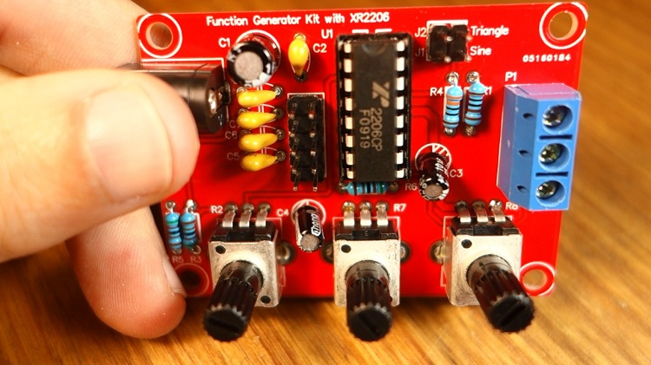
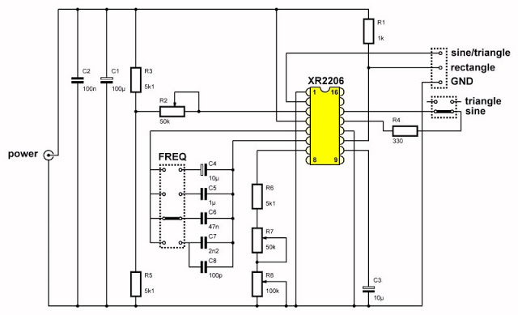
Building our function generator kit
Google finds several websites describing it, e.g.,
  https://chinese-electronics-products-tested.blogspot.com/p/geekcreit-xr2206-function-generator.html
  https://youtu.be/02XtneCHnDA?t=1427 has improvements

Slide 5
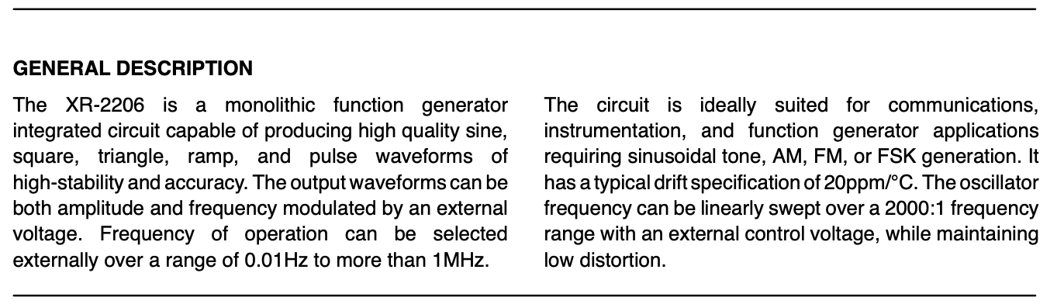
XR2206
Google “XR2206 datasheet pdf” and look for a pdf, e.g.,
  https://www.sparkfun.com/datasheets/Kits/XR2206_104_020808.pdf
What does “monolithic” mean in the title and first sentence of description?
  The IC is one piece of silicon (mono = one, lithos (Greek) = stone)
  It means its cheap(er) to make
Should be possible to automate control … how???

Slide 6
XR2206 datasheet
To navigate a data sheet, a good start is to flip through it quickly … what are the main sections, how many pages, maybe you find what you’re looking for right away, or maybe it will be much harder …
P. 2-3 – block diagram, pinouts, pin descriptions … ok
P. 4-5 – tables of parameters and specifications
P. 6 – Figure 2. Basic test circuit … let’s compare it to our kit’s “schematic”

Slide 7
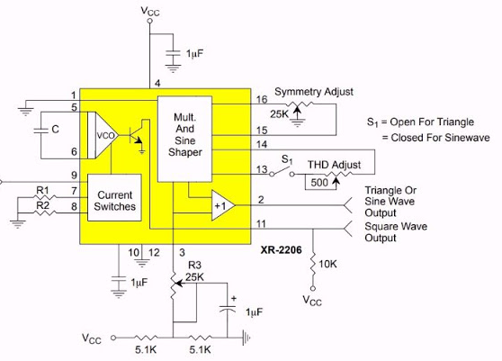
Building our function generator
The datasheet schematic (left) is much easier to follow, because it prioritizes functional clarity over physical connections
R1 is an “open collector pullup” → 10k (datasheet) maybe a better choice -- 12V/1k=12mA half the time → 6mA average current, 72mW average power (or 7mW with 10k). Absolute maximum power rating (p. 5) = 750mW, so we’ll be ok with 72)
Why C1 || C2?

Slide 8
Building our function generator
Datasheet R1||R2 = our R6+R7+R8 = timing resistor
Datasheet C (between pins 5&6) = our C4-8 selected by the frequency jumper (across pins 5&6)
Datasheet R3 (25k) is our R2 (50k)
Datasheet has a 500 ohm pot to adjust total harmonic distortion (THD), we have a fixed R4=330 ohms and jumper for S1
So overall, very similar → good, the datasheet descriptions should be largely relevant …

Slide 9
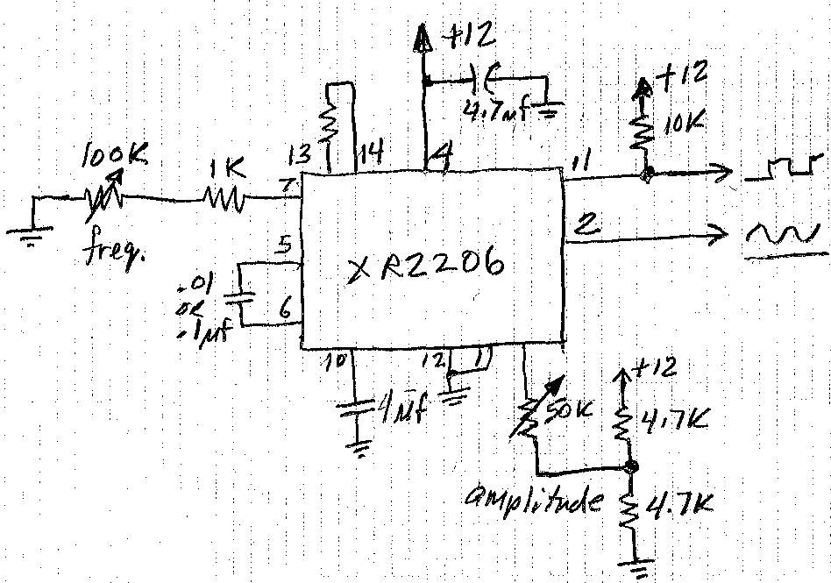
Before Covid …
We designed and built our own function generators without a kit
First prototype from Figs. 2 & 11 of XR2205 datasheet.
f = 1/RC
  f_{min} = 10Hz
  f_{max} = 10kHz w/.1uf
  10x that with.01uf
Output is offset by V_{cc}/2
This is complicated enough to prototype the simplest possible circuit. We’ll add split supply and other features later.
200
3
Build this on your breadboard

Slide 10
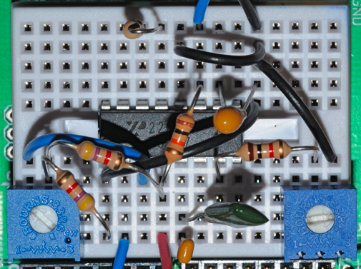
Function Generator prototype
Start with a minimalist circuit
Verify sine and square wave outputs on a scope, & both pots work as expected (volume and frequency increase clockwise).
What changes or features should we consider?
How will we lay this circuit out to solder (with minimal crossing of wires)?
sqr out
Gnd
amplitude
Sine out
+12
freq

Slide 11
How can we make it better?
How do we define “better”??
…

Slide 12
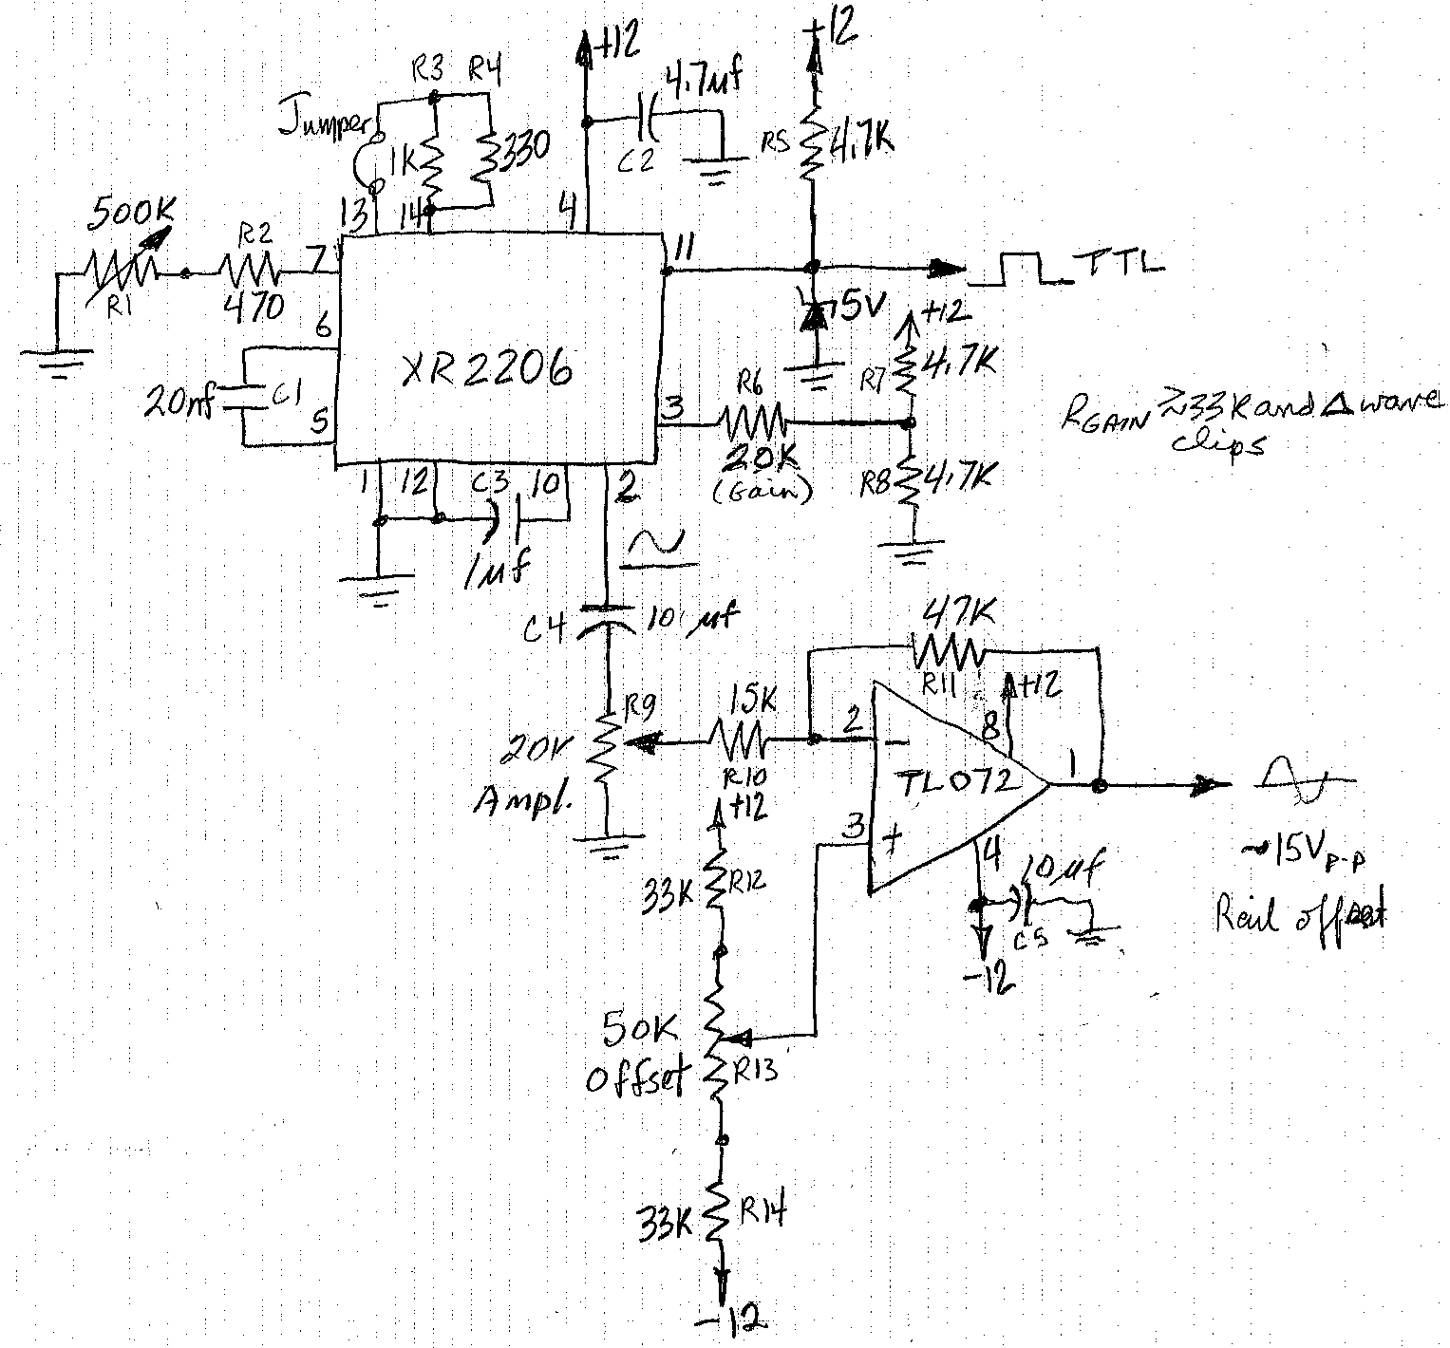
Improved Function Generator
Add an op-amp on the output to buffer the function generator, add bipolar output with wider amplitude control
Keep in mind to start simple and slowly, carefully embellish
R4 240Ω
1M
10k

Slide 13
PCB design
Printed circuit board, designed in Illustrator, implements all interconnections except 2 (blue) on one side of a 2”x2” copper clad circuit board.
Component side view with copper pattern grayed. Grid is 100 mil (.1”).
Note that traces generally run vertically and “vias” (blue) are horizontal. Geometry does matter in this physical abstraction of the circuit.
½”
Try doing this with Eagle …

Slide 14
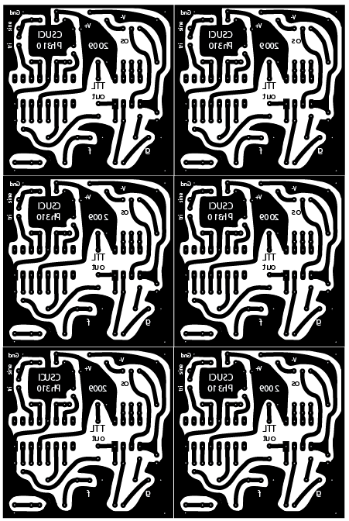
PCB layout
6 function generators fit on a 4”x6” negative photoresist circuit board.
  Large ground plane (and V+) minimizes etching
  Etched component holes are drill guides
To make a printed circuit board:
  Print this pattern on transparency film
  Place film on photoresist
  Expose to sunlight (exposure determined empirically, ~1 min)
  Develop to remove exposed photoresist
  Examine, touch up errors (with Sharpie)
  Etch unprotected copper
  Drill
  Scrape or dissolve photoresist (acetone)
  Place components and solder
  Score both sides of the board with a razor knife, then snap the 6 parts

Slide 15
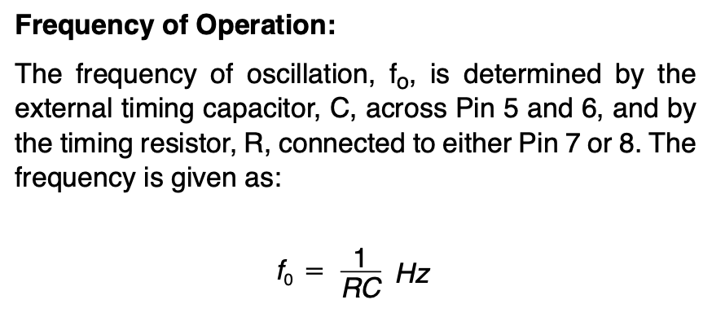
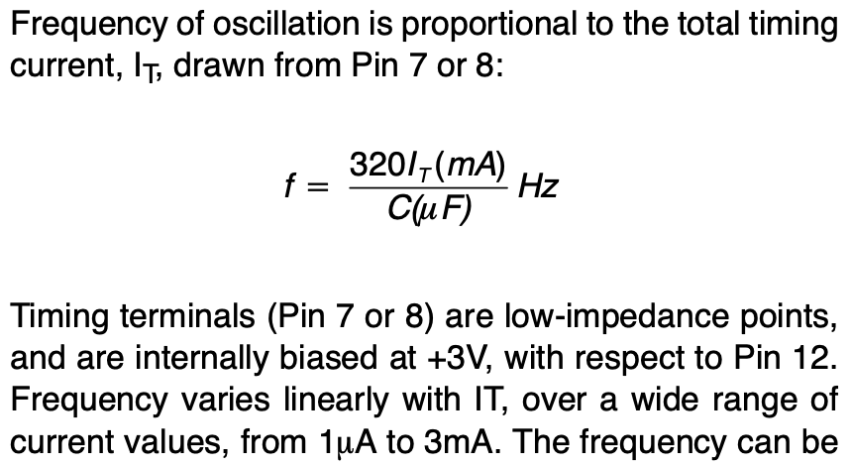
How is the frequency controlled??
P. 11, PRINCIPLES OF OPERATION
Just below that,
Manually, R is varied by R7+R8, and C by jumper
A current of 1uA-3mA can also set the frequency (are you thinking, “current mirror”!!??)

